Slide 1
Peer to Peer energy sharing platform with PV battery systems
Academic supervisor : Jinglan Zhang
Student name: Yixi Zhou
Student number: n9599291

Slide 2
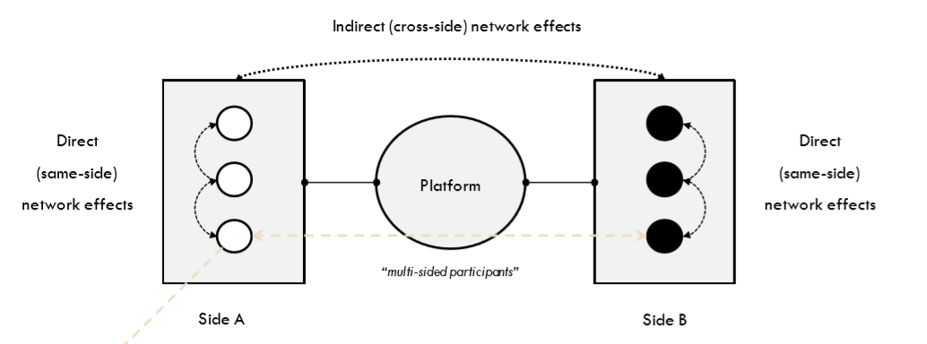
Background and context
web app that allows peer-to-peer power sharing

Slide 3
Type of P2P energy sharing architecture
block chain based
Offers a decentralized database to recognize the ownership of energy and organize multiple transaction agreements between sellers and consumers.
Online matching platform
Enables clients to buy electricity directly from DERs (small-scale distributed energy resources) sellers
battery storage based
Allows individual to store their surplus energy and sell to other community members in peak power consumption

Slide 4
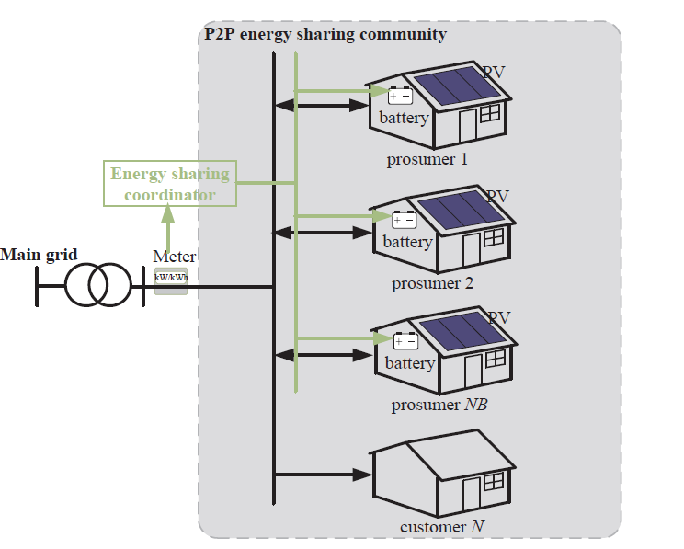
Architecture of P2P Electricity sharing system
Photovoltaic panels
Battery
Main grid
Energy sharing
Coordinator

Slide 5
Scheme system
Load Forecast :
use statistical learning to classify loads into user activates
Generator Forecast
Historical solar irradiation data is used to predict the solar profile for the day-ahead scheduler
Machine learning

Slide 6
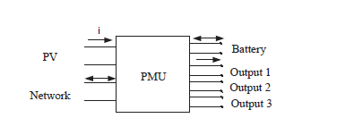
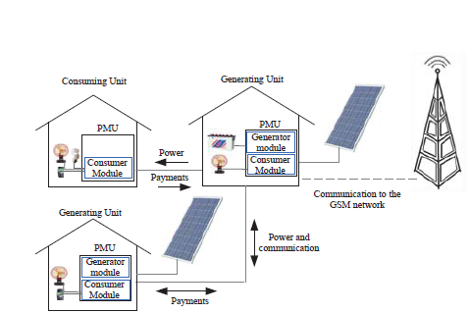
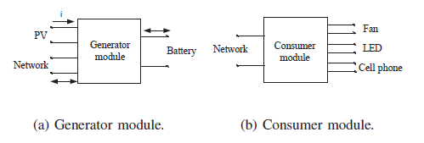
Power Management Unit
Real-time Dispatch: estimate for batteries 'charge states and load’s current power consumption.

Slide 7
Motivation
Falling costs in PV and rising retail electricity prices
Concern for climate change (traditional energy, such as fossil )
Greater control , autonomy and independence over energy costs and energy supply
Financial profit

Slide 8
Anticipated Significance
Increase the self-consumption ratio
Reduce carbon emissions
Enhance energy security and affordability for community
Manage distributed energy resources

Slide 9
Project scope
In scope:
1.Web application Interface to sell or buy electricity
Out scope :
1. Web application to control the house appliance
2. physical related device(PV and battery) installed
3. electric circuit design (micro grid network)
4. Scheme system to distribute solar energy
5. Power Management Unit to control charge or discharge in battery

Slide 10
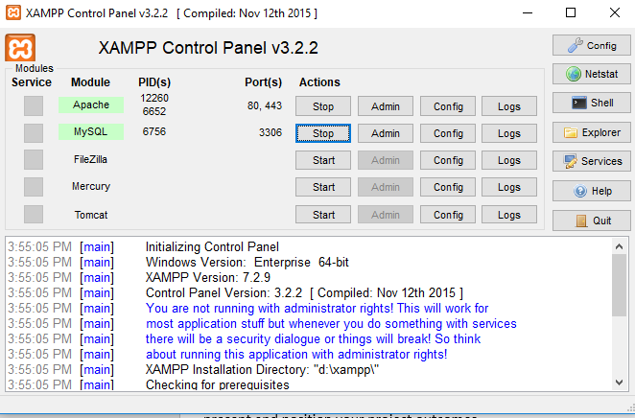
Overall approach
literature review : learn HTML , CSS and PHP
Use two tools:

Slide 11
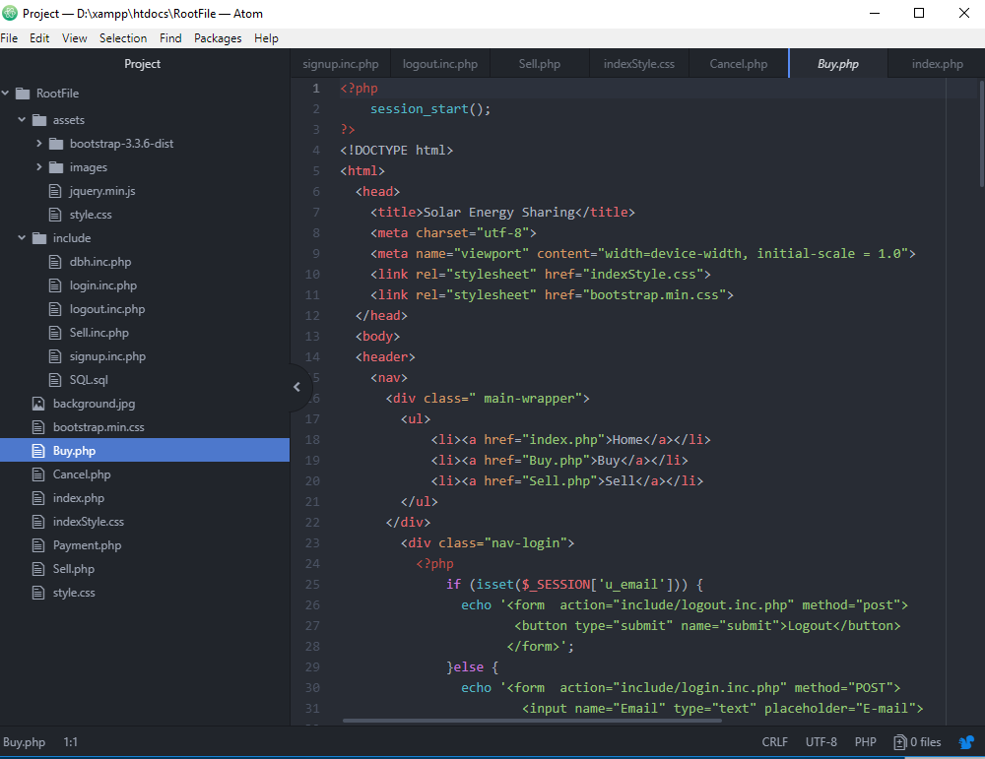
Overall approach
Text editor

Slide 12
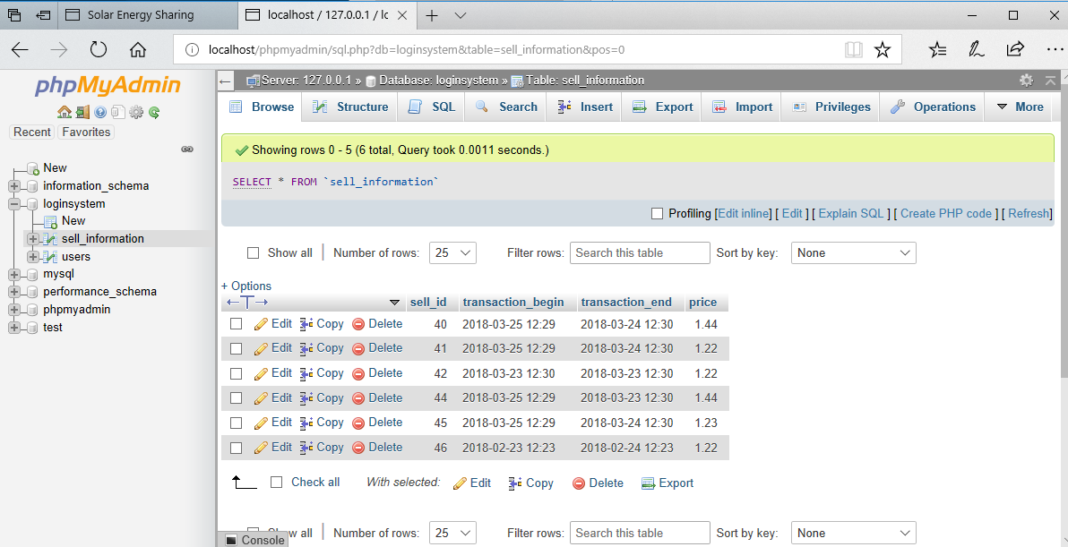
Overall approach
Create the database by MYSQL

Slide 13
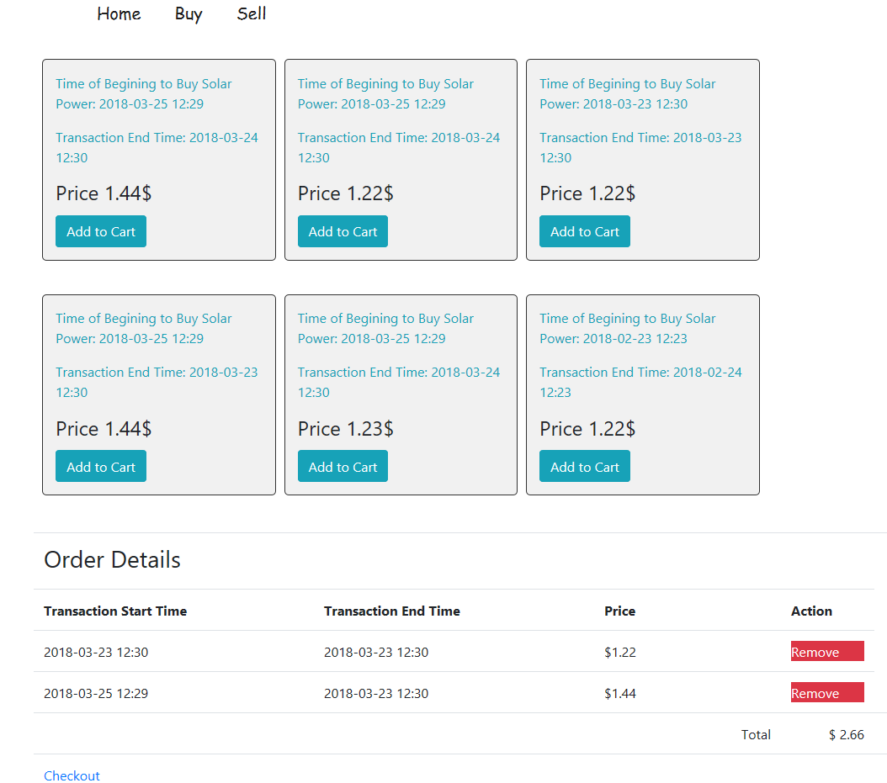
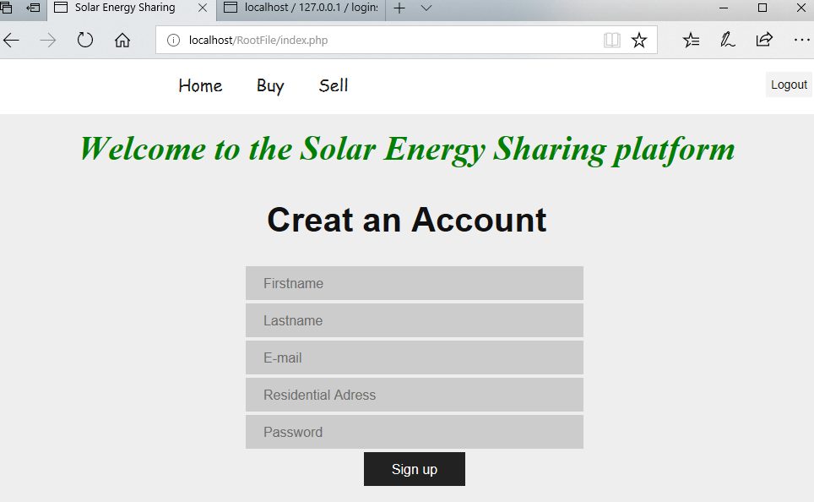
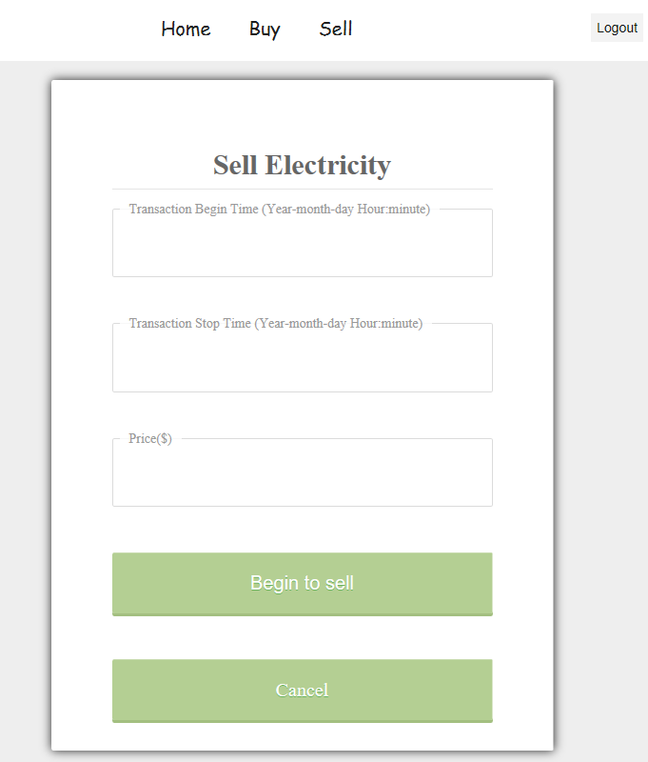
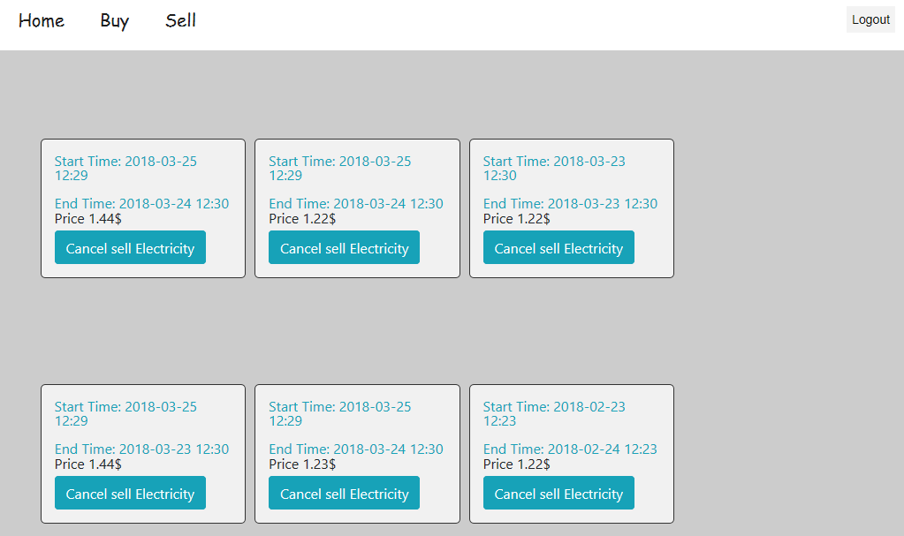
Overall approach
Design a simple interface by HTML and CSS (bootstrap)

Slide 14
Overall approach
Back end code use PHP (Hypertext Pre-processors)
Interact with HTML form to get the input information
Interact with SQL to manipulate the database

Slide 15
Overall approach
Login/login out function
1.Check the input information
2.Insert user information to database
3.sign in function
Buy/sell function
1. Insert sell information to database
2.Cancel transaction for seller
3. Cart function

Slide 16
Deliverables and outcome
Root File Fold (Web application interface)
Contain HTML, CSS and PHP source code for web application
Literature review for P2P solar power sharing system
1.Web application Interface
2.Scheme system
3.Power Management Unit

Slide 17
implications of outcomes
More user friendly interface
Get the distance between sellers and buyers by google API
More user friendly check for input information
Security function

Slide 18
Reference
Burman, C. J., & Aphane, M. A. (2016). Leadership emergence: the application of the Cynefin framework during a bio-social HIV/AIDS risk-reduction pilot. African Journal of AIDS Research, 15(3), 249-260. doi:10.2989/16085906.2016.1198821
Inam, W., Strawser, D., Afridi, K. K., Ram, R. J., & Perreault, D. J. (2015). Architecture and system analysis of microgrids with peer-to-peer electricity sharing to create a marketplace which enables energy access (pp. 464-469): Korean Institute of Power Electronics
Long, C., Wu, J., Zhou, Y., & Jenkins, N. (2018a). Aggregated battery control for peer-to-peer energy sharing in a community Microgrid with PV battery systems. Energy Procedia, 145, 522-527. doi:10.1016/j.egypro.2018.04.076
Long, C., Wu, J., Zhou, Y., & Jenkins, N. (2018b). Peer-to-peer energy sharing through a two-stage aggregated battery control in a community Microgrid. Applied Energy, 226, 261-276. doi:10.1016/j.apenergy.2018.05.097
Ruotsalainen, J., Karjalainen, J., Child, M., & Heinonen, S. (2017). Culture, values, lifestyles, and power in energy futures: A critical peer-to-peer vision for renewable energy. Energy Research & Social Science, 34, 231-239. doi:10.1016/j.erss.2017.08.001

Slide 19
Thank you for listening Are there any questions ?

